Slide 1




ETL 1 :
Building the Data Pipeline
Laura Belmond - Solution Engineer

Slide 2
TABLE
OF CONTENT
Introduction : What is this workshop about ?
The modern data stack
Tips
Use case

Slide 3
Who am I ?
Who are you ?
What is your Dream job after the master ?
Align your aspirations with the skill you will develop during this workshop.

Slide 4
Final Evaluation & Deliverables
Groupe project : 5 people
Architecture plan: end-to-end retail pipeline (Slides/PDF).
Pipeline code: Python/SQLAlchemy → Snowflake ingestion (GitHub repo).
Real-time streaming: Kafka integration demo (video/screenshot).
Automation: Snowflake scheduling script + video of pipeline running in production (cloud/on-prem).
Monitoring: Tableau retail dashboard.
Quality & Governance: validation scripts + data quality report (Word/PDF).

Slide 5

Final Evaluation & Deliverables
Groupe project : 5 people = 5 roles. Example :
Chief Information officer (gouvernance focus)
Data visualization (Dashboard Focus)
Data engineer I (pipeline & automation)
Data engineer II (pipeline & automation)
Head of Architect (Architecture design )

Slide 6
Today Deliverables : individual Hands out
Notebook & screen of your Snowflake page

Slide 7
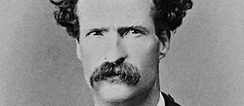
Mark Twain speaking FACTS
“Data is like garbage. You’d better know what you are going to do with it before you collect it.

Slide 8
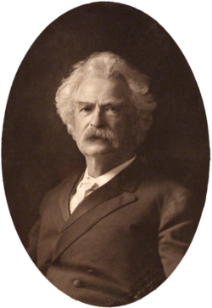
Building a Data Pipeline, why ?
The goal is to design, automate, and monitor end-to-end data pipelines that meet real-world business requirements, in 18 hours.
The sessions will have:
Query challenges
Lab sessions
Definitions & key concepts in blackboard (after the session)
Individuals assignments & group project
Keep your final user in mind
(Mark Twain)

Slide 9
TABLE
OF CONTENT
Introduction : What is this workshop about ?
The modern data stack
Tips
Use case

Slide 10
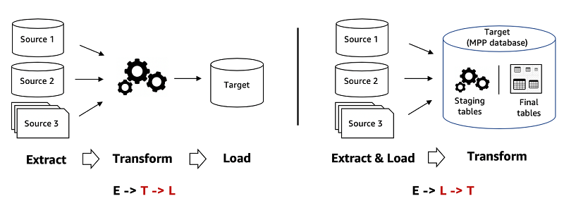
ETL, ELT

Slide 11
Evolution of Data Management
Table-based Data Warehouse
File-based + Table-based Data Lake / Lakehouse
Borderless Data with the Data Cloud
Notes:
That’s why we believe the next wave of data management or architecture approach is more about how can be shared and consumed by not only your internal teams, but your customers, partners, and even opportunities to monetize your data, and of course with different types of data. And that’s why the Snowflake data cloud is our answer.

Slide 12
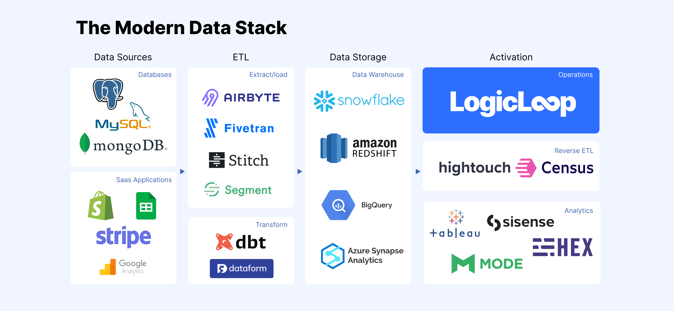
The overwhelming data stack
Source LogicLoop

Slide 13
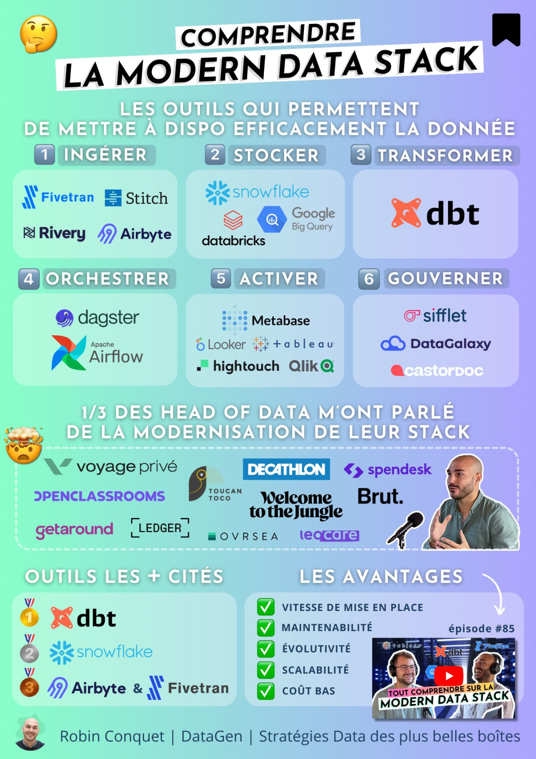
The modern Data Stack
A modern data stack is a set of cloud-based technologies that enable organizations to collect, store, process, and analyze large amounts of data from various sources, providing a single, unified view of their business. This stack is designed to be flexible, scalable, and secure, allowing companies to make data-driven decisions faster and more accurately.

Slide 14
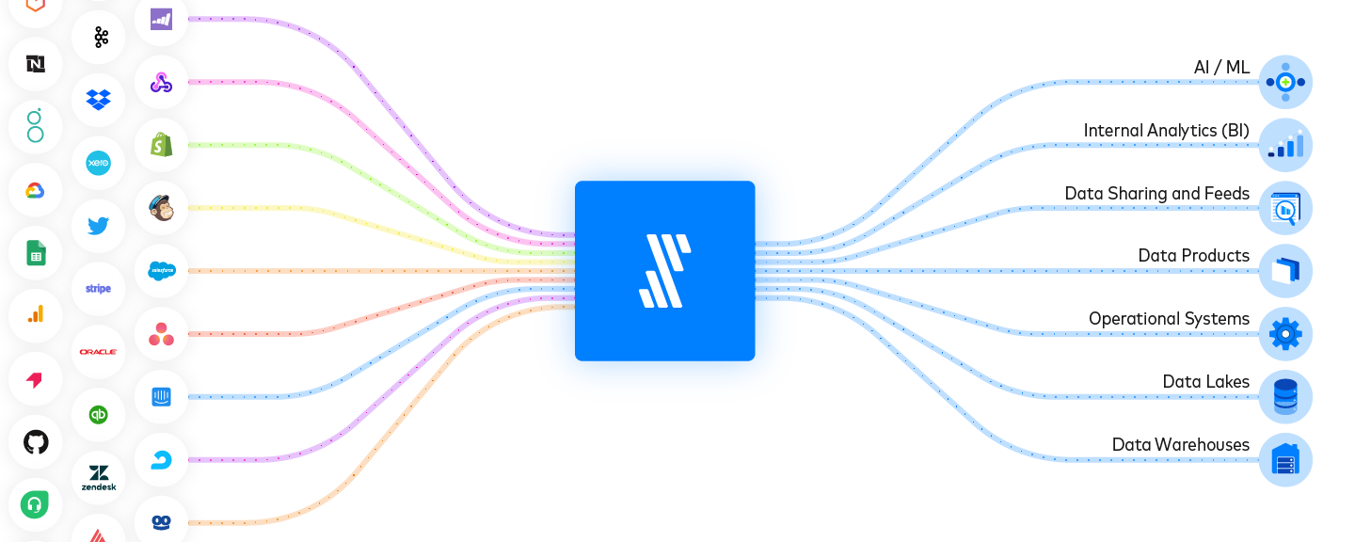
Fivetran

Slide 15
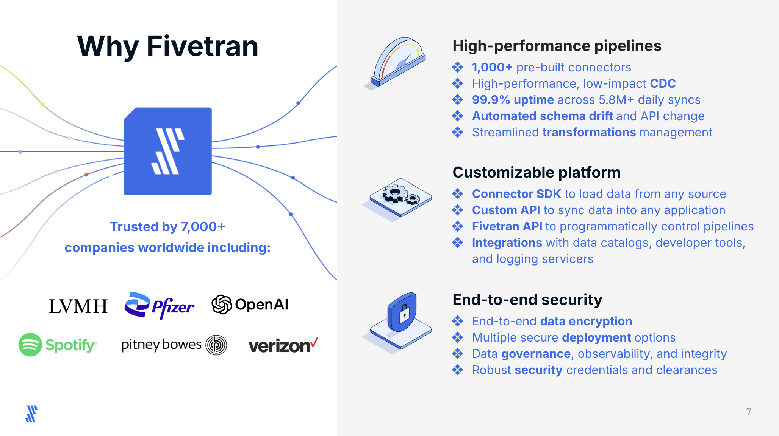

Slide 16
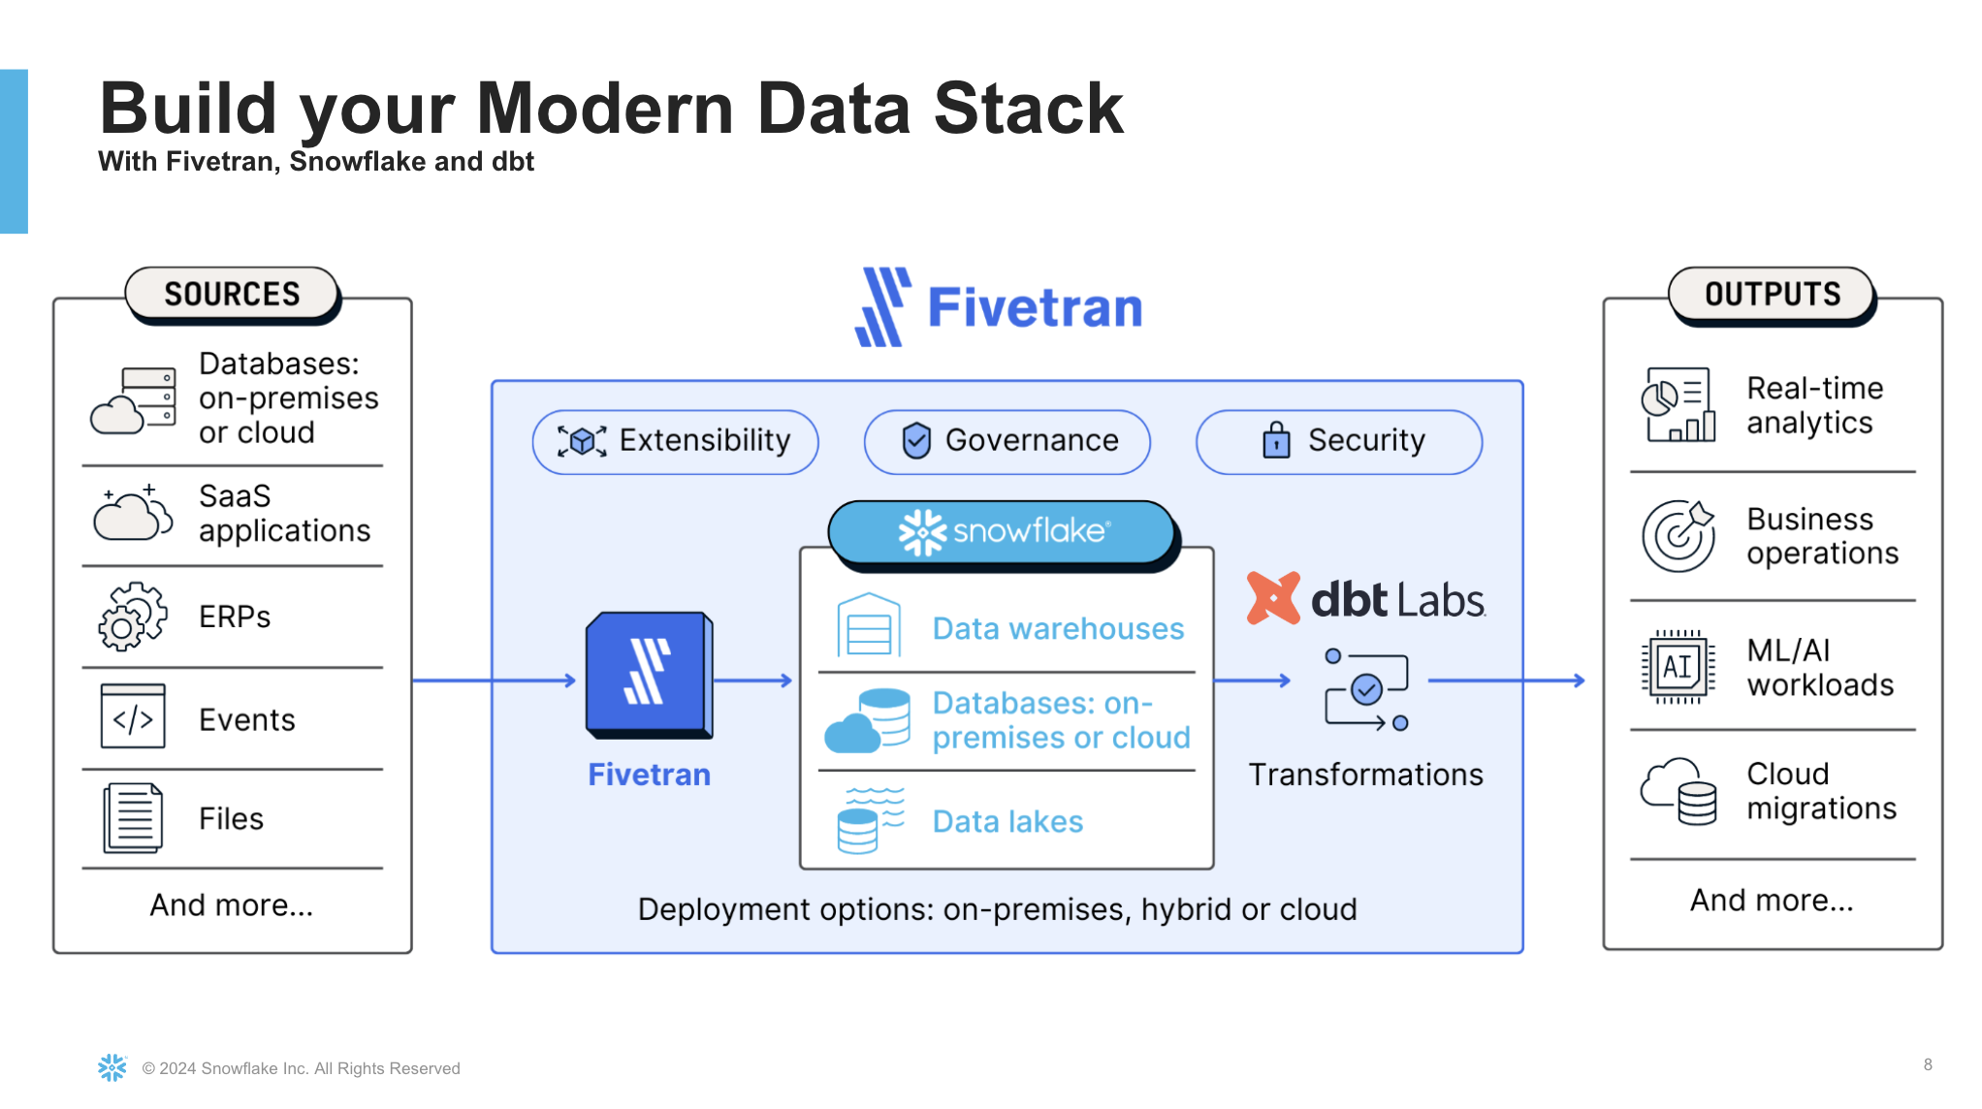

Slide 17
SNOWFLAKE PLATFORM
Technical Deep Dive

Slide 18
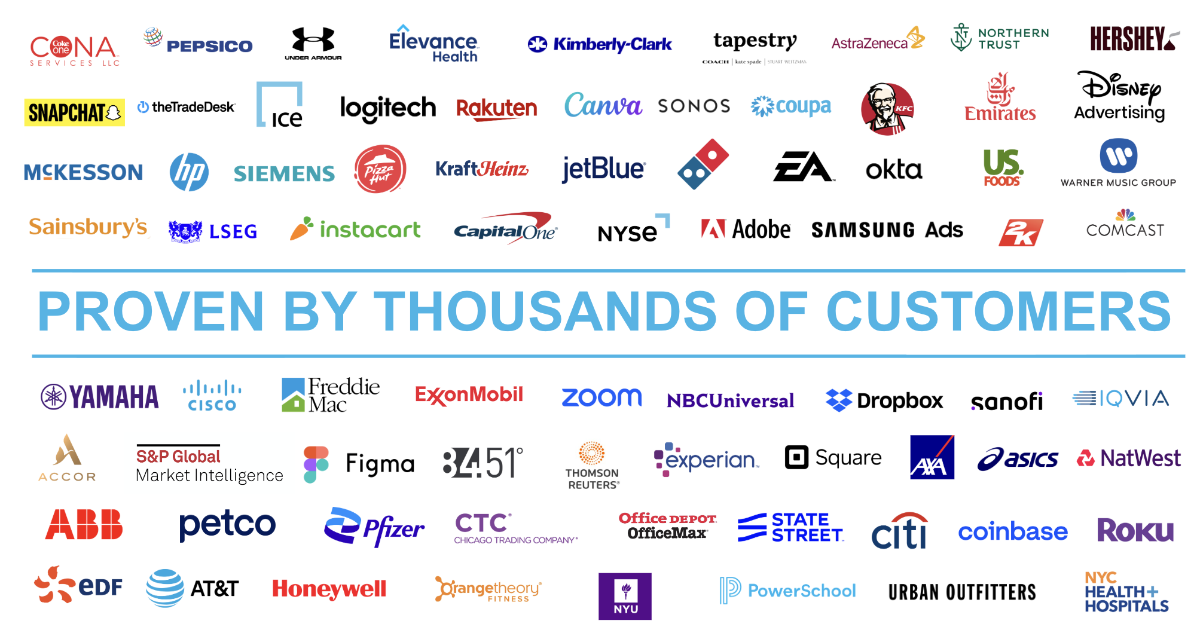

Slide 19
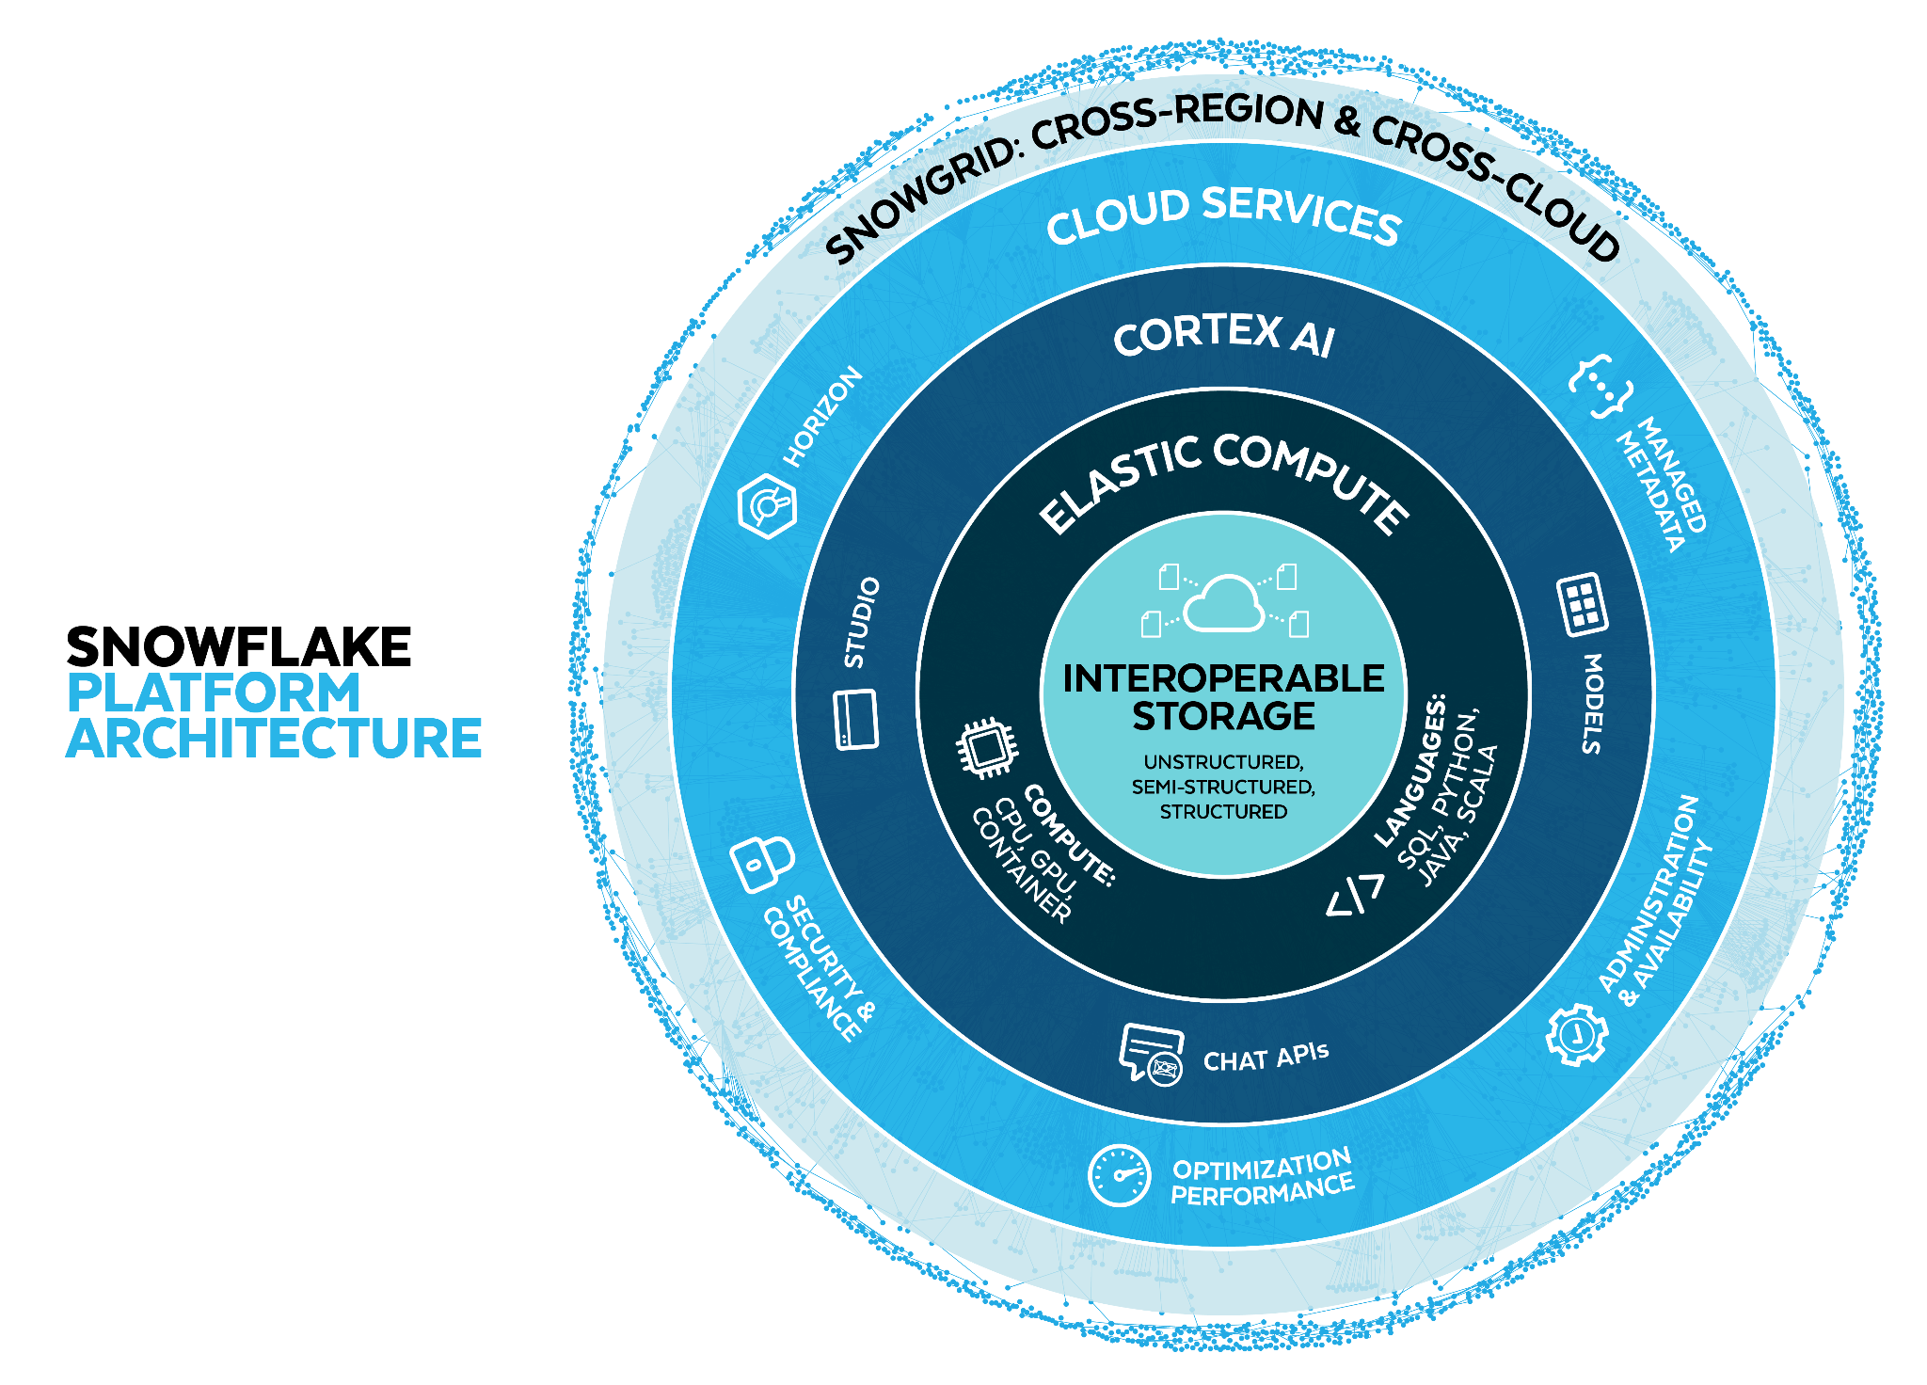
Notes:
A key development philosophy for Snowflake is the power of one. Having one single platform pays off in countless ways - from drastically simplifying things for our customers to accelerating Snowflake’s own engineering impact. But we are adamant in ensuring that one platform doesn’t result in any trade-offs. So we’ve developed 4 unique architectural layers, all integrated together within Snowflake’s one platform, that deliver on those critical requirements without trade-offs:
Optimized storage
Elastic Multi-Cluster Compute
Cloud Services
Snowgrid

Slide 20
Powering Many Workloads
Collaboration
Discover, access and monetize live data, services and apps in the AI Data Cloud
Data Engineering
Build simple, reliable data pipelines at scale in the language of your choice
AI/ML
Accelerate your ML workflow with fast access and elastically scalable processing
Applications
Build data-intensive applications without operational burden
Data Warehouse
Accelerate analytics for users and queries with leading price / performance and no complexity
Data Lake
Deploy flexible architectural patterns with governance and optimized storage at scale
Unistore
Delivers a modern approach to working with transactional and analytical data together
Notes:
These layers come together to unlock a wide range of workloads to drastically simplify your architectures and enable end-to-end workflows - bringing together different teams and breaking down organizational silos.
From foundational workloads such as data warehousing, data lakes, or Unistore (which finally brings transactional and analytical data together); to applied workloads across Collaboration, data engineering, cybersecurity, AI and ML, and applications - there’s virtually no limit to what you can run on Snowflake.
[For reference: quick talking points for each workload]
Data Warehouse to accelerate analytics with leading price-performance
Data Lake to deploy flexible architectural patterns with governance and optimized storage
Unistore to deliver a modern approach to working with transactional and analytical data together
Collaboration to discover, access, and monetize more than just data
Data Engineering to build simple, reliable pipelines in the language of your choice
Cybersecurity to protect your enterprise with near-unlimited visibility and powerful analytics
Data Science and ML to accelerate ML workflows with fast access and scalable processing
Applications to build data-intensive apps without operational burden

Slide 21

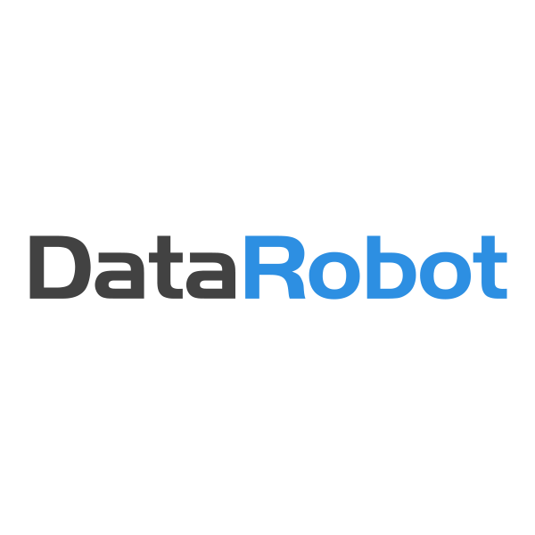

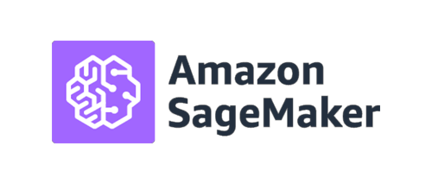


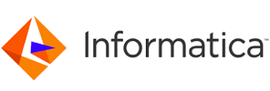





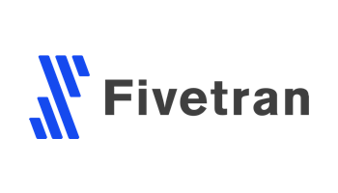







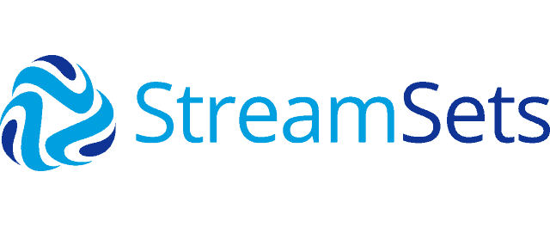
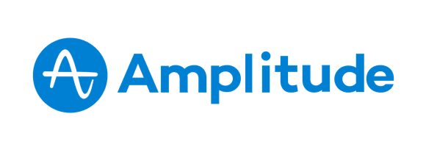





Data Science
ETL/ELT
Marketing Analytics/Reporting/BI
M
Structured
Semi-Structured
Unstructured
Data Load
M
XS
S
S
Data Transformation
L
Intelligent Infrastructure:
Data Science
Logical Model
Security
Query Planning & Optimization
Transactional Control

Slide 22
3 Dimensions of Scaling
ACROSS
Many competing workloads
Resource contention
Isolate on separate warehouses
Notes:
The first dimension of scaling is scale-across. This is about handling multiple competing workloads at the same time. Think of data loads, reporting queries and data science users all hitting the system at the same time.
In a traditional system, you might use workload management queues to separate out the queries (but you could still face contention over IOPS). In Snowflake, we use multiple warehouses.

Slide 23
ETL/ELT
Marketing Analytics/Reporting/BI
M
Structured
Semi-Structured
Unstructured
Data Load
M
XS
S
S
Data Transformation
L
Intelligent Infrastructure:
Data Science
Logical Model
Security
Query Planning & Optimization
Transactional Control
Notes:
** Click to animate the points of interest.
Here, we are separating the workloads across the three warehouses and Snowpipe.
Each workload is guaranteed to be protected from impact from the others.
Each warehouse can be sized appropriately for the workload it is supporting. It only runs for the time required by the workload.
Compared to a traditional system, the Snowflake model is not a zero-sum game:
If we have a new workload, we simply add a new warehouse for it, sized and timed for the new workload so we tightly match the demand curve.
Because Snowflake is not a reserved capacity model, we do not need to steal resources from other warehouses to add a new warehouse. We just grab more servers from the pool for the time we need them, then we give them back.
Capacity planning becomes trivially simple - how much resource do I need for this workload right now?-

Slide 24
3 Dimensions of Scaling
UP
Single query performance
More data, more complex queries
Add more servers to the cluster
ACROSS
Many competing workloads
Resource contention
Isolate on separate warehouses
Notes:
The second dimension of scaling is about dealing with larger data volumes and more complex queries.
The solution here is to scale a cluster up - i.e. adding more servers to the cluster.
Each query now has more resources (CPU, RAM) to process the data.

Slide 25
ETL/ELT
Marketing Analytics/Reporting/BI
M
Structured
Semi-Structured
Unstructured
Data Load
M
XS
S
S
XL
Data Transformation
L
Intelligent Infrastructure:
Data Science
Logical Model
Security
Query Planning & Optimization
Transactional Control
Notes:
Imagine your data science team has a set of queries they run. On a small (2-node warehouse) this takes 2 hours to complete. This limits the number of iterations they can make in a day.
** Click to show scale-up on the data science warehouse.
In Snowflake, we can instantly scale a warehouse up (or down). The warehouse does not need to be stopped and queries can immediately be optimised for the new warehouse scale.
Coming back to our example - we resize the warehouse from small to xlarge. This is an 8x increase in size to 16 nodes in the cluster. If I have enough work to keep the warehouse fully loaded, I can expect to see linear improvement. So their set of queries now complete in 15 mins instead of 2 hours.
But here’s the interesting thing about Snowflake - we charge per server, per second. So if you increase the number of nodes by 8 and reduce the runtime by 8, it costs the same.
Just let that sink in. Faster results. Same cost. It’s counter-intuitive.

Slide 26

3 Dimensions of Scaling
UP
Single query performance
More data, more complex queries
Add more servers to the cluster
ACROSS
Many competing workloads
Resource contention
Isolate on separate warehouses
Out
More users
More queries simultaneously
Spin up more clusters
3 DIMENSIONS OF SCALING
UP
- single query performance
- more data, more complex queries
- add more servers to the cluster
ACROSS
many competing workloads -
resource contention -
isolate work to separate clusters -
OUT
- more users
- more queries simultaneously
- spin up more clusters
Notes:
The third dimension to scalability is dealing with concurrency - increasing numbers of users mean we have to run more queries simultaneously.
Traditional systems use the same knob as before - scale-up - but this isn’t overly effective.
What you really need is scale-out - spreading the queries across more clusters.

Slide 27
ETL/ELT
Marketing Analytics/Reporting/BI
M
Structured
Semi-Structured
Unstructured
Data Load
M
M
XS
Multi-cluster
S
S
Data Transformation
L
Intelligent Infrastructure:
Data Science
Logical Model
Security
Query Planning & Optimization
Transactional Control
Notes:
A common situation where we see scale-out challenges is in reporting/dashboards.
We normally have 5 users logged into the system and we’ve sized the warehouse as a medium - this works well for our baseline load.
But at end of month/end of quarter, we don’t have 5 users - we have 50 users. And our traditional experience is that performance crashes because the warehouse saturates.
Note that the volume of data hasn’t increased, and the queries haven’t gotten more complex. We just have more of them hitting the system at the same time.
** Click to show scale-out.
The solution in Snowflake is to scale-out in a multi-cluster warehouse. We spin up additional clusters (in this example we start more 4-node clusters) and we spread the incoming queries across them.

Slide 28





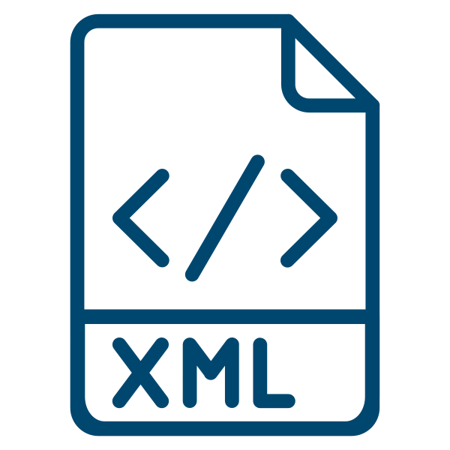




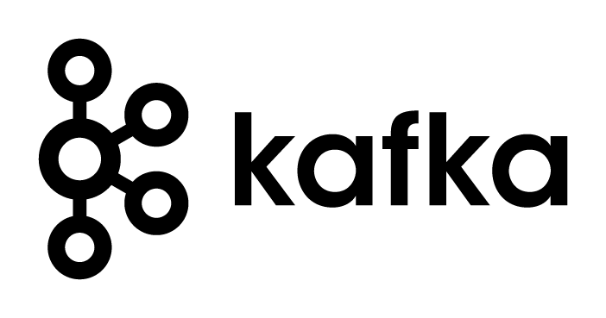




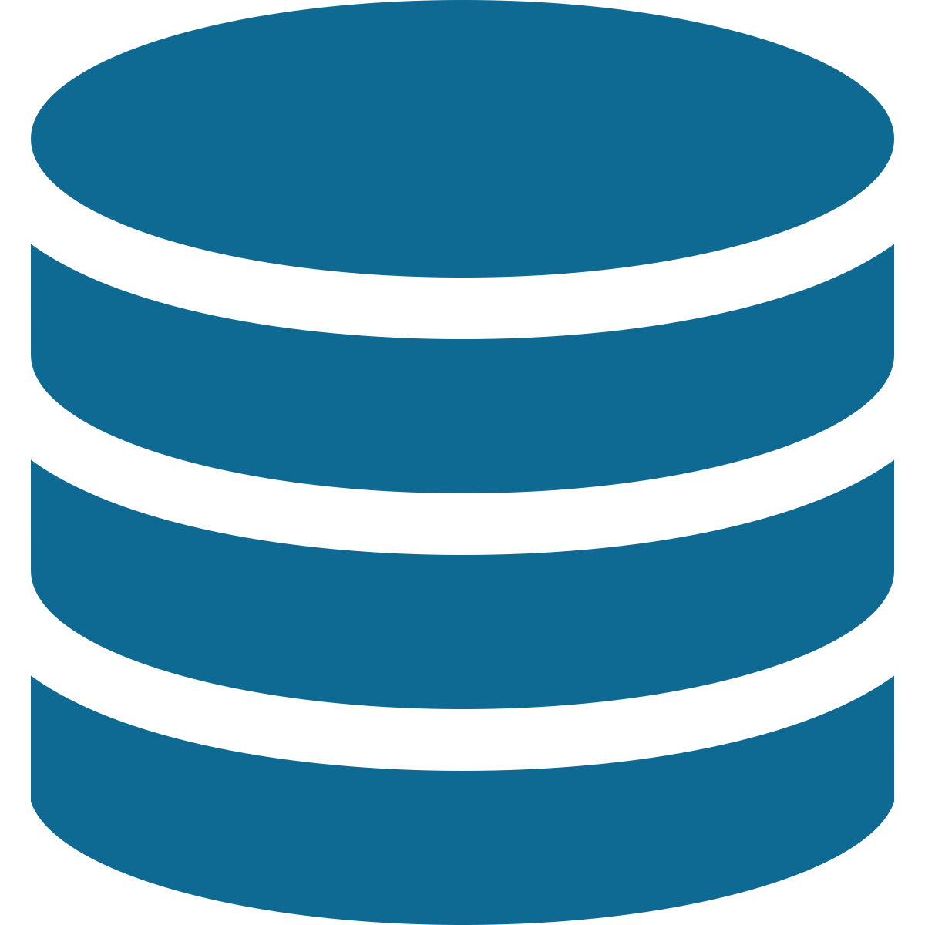
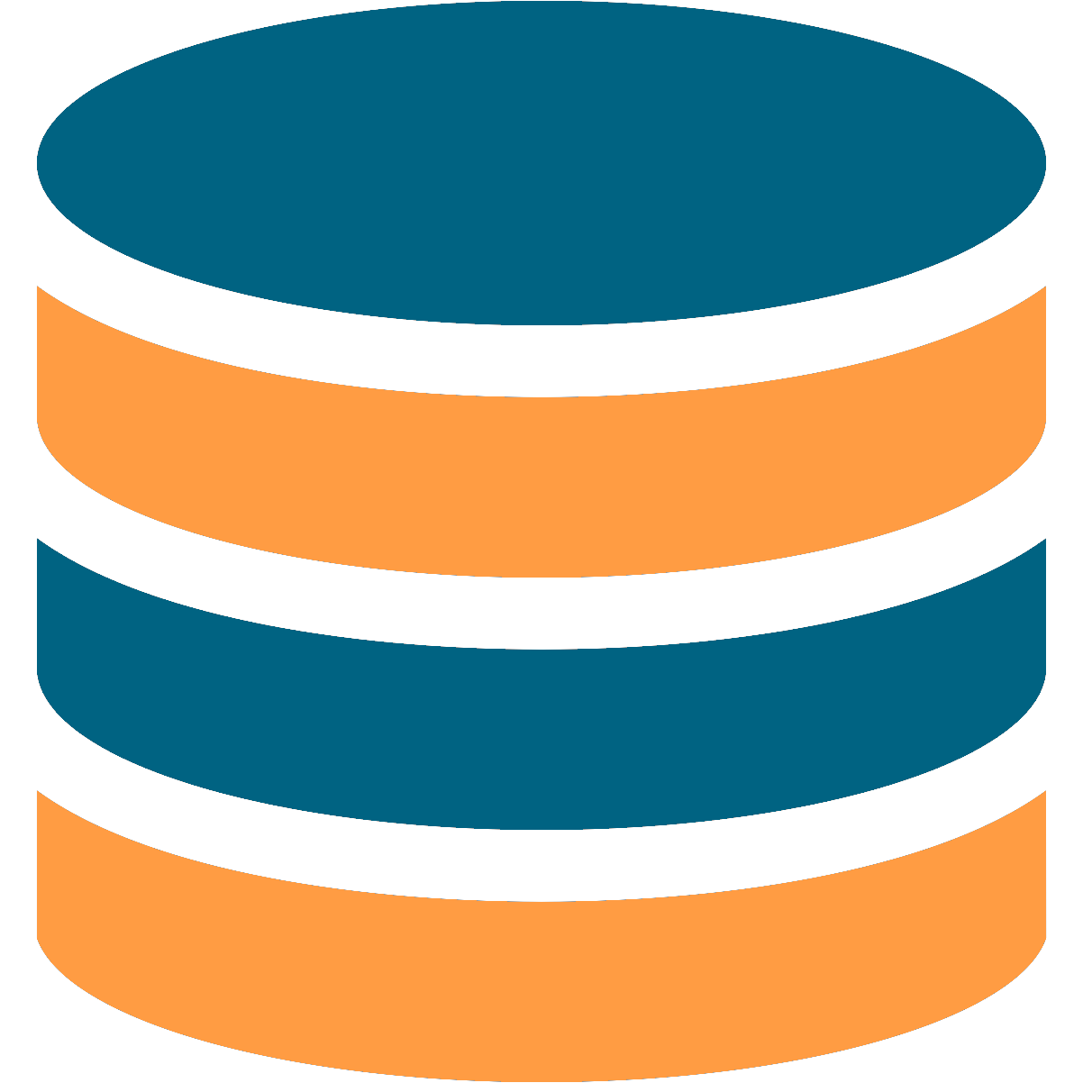







External
M
ETL/ELT
Sales
Structured & semi-structured
XS
M
…
M
Data Sharing
Multi-cluster
Snowpipe
Tasks, Streams
Clone
S
XL
XL
Data protection & time travel
Global Services
DevOps
Data Science
Logical Model
Security
Query Planning & Optimisation
L
Transactional Control
Finance/DBAs
ETL/ELT
Marketing Analytics/Reporting/BI
Structured
Semi-Structured
Unstructured
Data Load
M
M
XS
Multi-cluster
Your Business Ecosystem
Snowflake Marketplace
Privacy-Preserving Collaboration
M
Your Teams & Internal Users
XL
Clone
S
S
Data Transformation
Data Protection
& time travel
Intelligent Infrastructure:
DevOps
Data Science
Logical Model
Security
L
Query Planning & Optimization
Transactional Control
Finance/DBAs

Slide 29

Interoperable Storage
Unsiloed access to your data
Unstructured, semi-structured, and structured data together with near-infinite scale.
Easily manage data at scale
Fast and efficient access, optimized compression, and secure data - all automated.
Flexibility & interoperability
Work with data on-premises or in open table formats* to remove lock-in and adapt to new data patterns.
Cloud
On-Prem
Open Source
Structured
Semi-structured
Unstructured
* in public preview
Notes:
What you get:
Scale: Under the hood this layer is built on infinitely elastic, efficient cloud storage so you don’t have to migrate your data as it grows.
All types of data in one place. From structured ERP data to high-volume semi-structured XML or JSON to unstructured PDFs or images. No more silos based on the type of data.
Efficient micro-partitions using Snowflake’s proprietary table format. Built-in encryption, compression. Superior query performance.
Snowflake-managed Metadata: Snowflake manages metadata as operations are performed, enabling ACID transactions, time-travel, zero-copy-cloning on top of this data.
Flexibility and interoperability:
You can choose to deploy any pattern that works for your organization - data warehouse, data lake, data mesh, or data fabric.
Open: with Iceberg tables, you get all the benefits of this architecture (optimized performance, security, governance) on data that lives in your AWS account. Read+write using Apache Iceberg, or access data from a cloud data lake, or S3-compatible on-prem
Optimized storage is what puts nearly all data at your fingertips. This is critical to making machine learning models more accurate, insights more actionable, and data applications so much more powerful.
Snowflake’s platform allows you to access and process structured, semi-structured, and unstructured data together at practically any volume. No more silos of data depending on the data type, or delays in getting access to the data you need when you need it.
With all that data together, Snowflake also provides unique automations and optimizations to keep your data fast, efficient, and secure at scale. This means you can trust your data is secured and governed, with capabilities such as encryption by default. Built-in storage compression lets you store all your data cheaper, just by bringing it to Snowflake. And with our unique always on micropartitioning, you get fast access to data even at petabyte scale.
Finally, for most customers, there’s no one size fits all model when it comes to architecting data for your business. Whether you are looking to deploy a data lake, data warehouse, hybrid model, data mesh, or otherwise, Snowflake’s flexibility allows you to constantly adapt to whatever best suits your business needs. Plus, with interoperability to connect with data on-premises or stored in open table formats like Apache Iceberg, you can extend the value of the Data Cloud and Snowflake’s platform to your entire data estate.

Slide 30


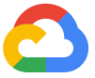
Snowflake Supported Regions
Available on customer’s cloud & region of choice
Generally Available
US West (Oregon)
US East (Ohio)
US East (N. Virginia)
Canada (Central)
US Gov West 1*
US Gov West 1 - DoD**
US Gov East 1*
US East (Commercial Gov – N Virginia)***
EU (Ireland)
Europe (London)
EU (Paris)
EU (Frankfurt)
EU (Stockholm)
Asia Pacific (Tokyo)
Asia Pacific (Osaka)
Asia Pacific (Seoul)
AWS Pacific (Mumbai)
Asia Pacific (Singapore)
Asia Pacific (Sydney)
Asia Pacific (Jakarta)
South American (Sao Paulo)
US West (Commercial Gov - Oregon)***
Generally Available
West US 2 (Washington)
Central US (Iowa)
South Central US (Texas)
East US 2 (Virginia)
Canada Central (Toronto)
US Gov (Virginia)****
US Gov (Virginia)**
UK South (London)
North Europe (Ireland)
West Europe (Netherlands)
Switzerland North (Zurich)
UAE North (Dubai)
Central India (Pune)
Japan East (Tokyo)
Southeast Asia (Singapore)
Australia East (New South Wales)
Coming Soon
Mexico Central (Querétaro State) - Q4 FY25
Generally Available
US Central 1 (Iowa)
US East 4 (N. Virginia)
Europe West 2 (London)
Europe West 3 (Frankfurt) Europe West 4 (Netherlands)
Coming Soon
ME Central 2 (Dammam) - Q4 FY25
* FedRAMP High
** IL4 Authorized; IL5 In Progress
*** FedRAMP Moderate
**** FedRAMP High In Process

Slide 31

Goldman Sachs Connects Teams and Drives Collaboration with Secure Data Sharing & Snowflake Native Apps
“The idea is to reduce friction and bring data as quickly and as smoothly as possible into the hands of our users.
Now, it’s easy for data engineers to produce apps and distribute them, And, it's easy for our researchers and other business teams to use the data quickly. A perfect example of a win-win for all stakeholders.”
Abhishek Narang, Managing Director, Data Engineering

Slide 32


Slide 33
TABLE
OF CONTENT
Introduction : What is this workshop about ?
The modern data stack
Tips
Use case

Slide 34
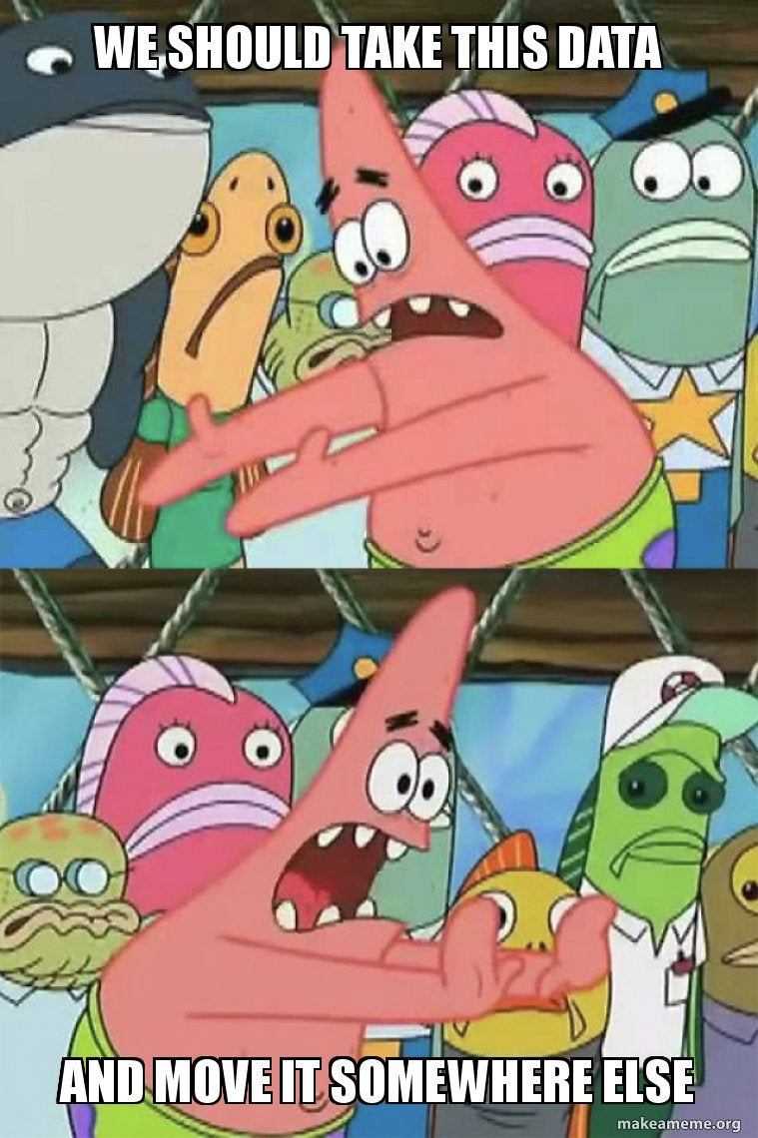
TIPS
This is the most important session
Spend time to understand snowflake as we will reuse the platform
TroubleShooting with ChatGPT
Better than doing everything with chatGPT
Have Fun
Data should never be boring

Slide 35
TABLE
OF CONTENT
Introduction : What is this workshop about ?
The modern data stack
Tips
Use case

Slide 36
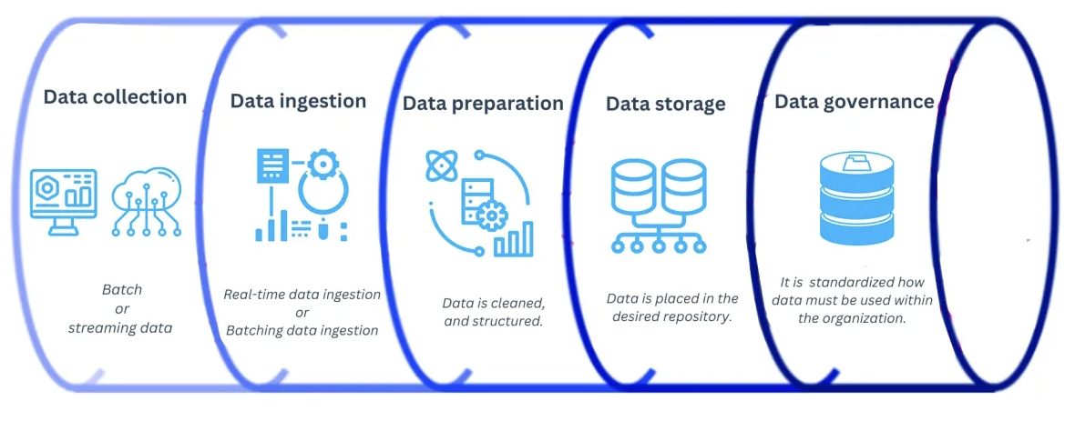
Ingestion : hands on

Slide 37
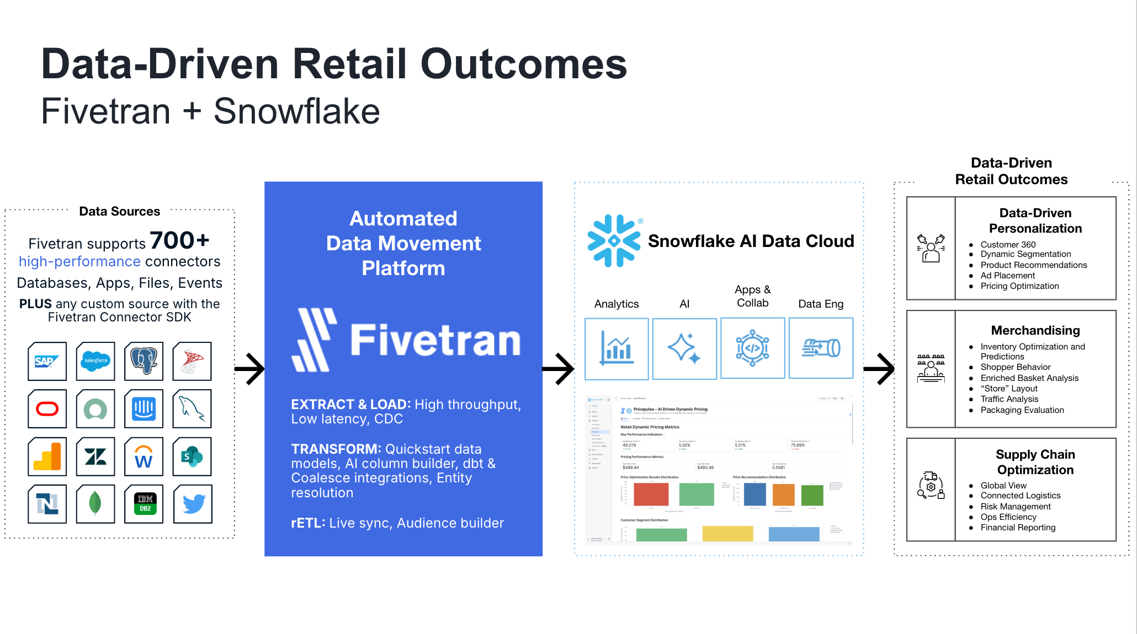

Slide 38




KDmerch : Kpop Demon hunter inventory issue

Slide 39
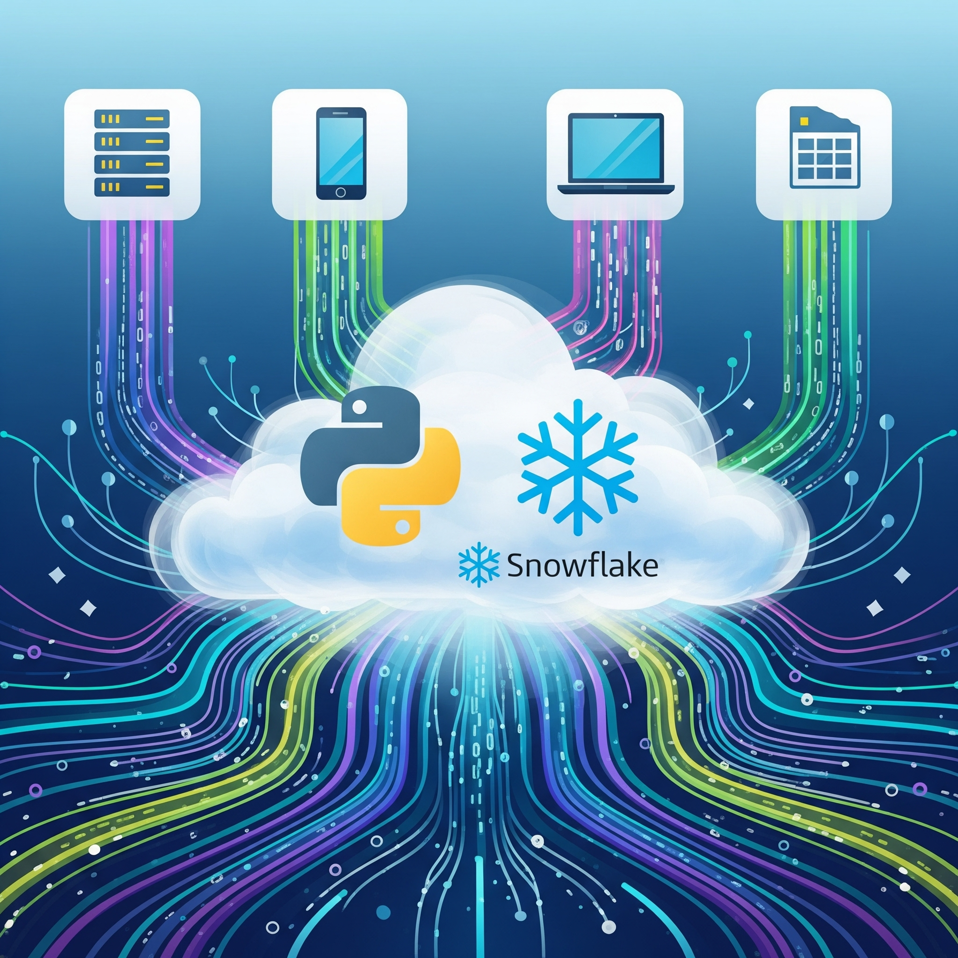
BEWARE OF SOME TRAPS
Today let’s help KDmerch
There are many different ways to get data into Snowflake. Different use cases, requirements, team skillsets, and technology choices all contribute to making the right decision on how to ingest data. I’ll try to guide you through an example of the same data loaded with different methods:
SQL Inserts from the Python Connector
File Upload & Copy (Warehouse) from the Python Connector
File Upload & Copy (Snowpipe) using Python
File Upload & Copy (Serverless) from the Python Connector

Slide 40
What you need
Windows
What You'll Need
Snowflake Account
WSL with Ubuntu for Windows
Docker Installed in Ubuntu
Conda Installed in Ubuntu
VS code
Mac
What You'll Need
Snowflake Account
Docker Installed
Conda Installed
VS code

Slide 41
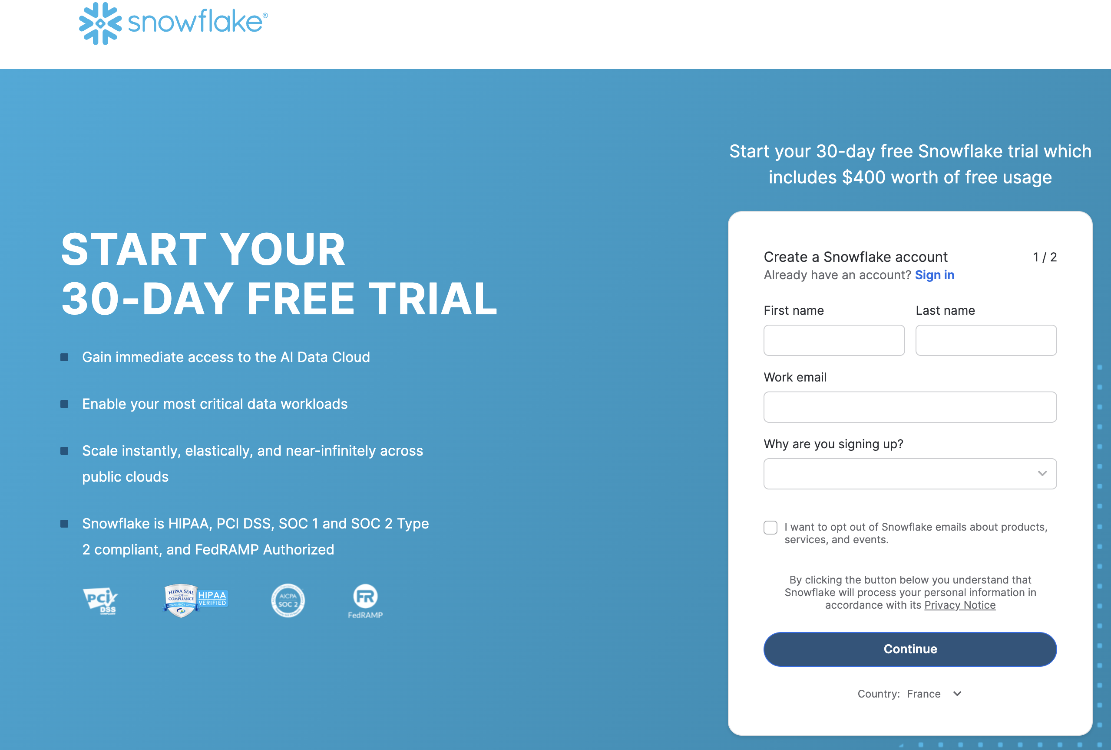

Slide 42
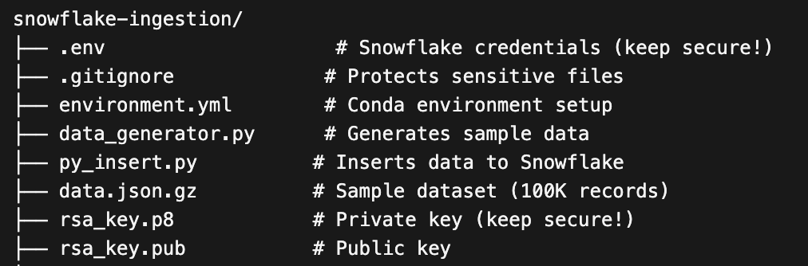
Project structure

Slide 43
THANK YOU
For Your Precious Time and Attention.

Slide 44

Extra work : Sell me Dubai Chocolate
Dubai gold chocolate company (DGC) problem:
Pick of demand
No inventory strategy
On premise data stack
Your pipeline should handle:
At least 100 concurrent orders per minute
<1 seconde delay
Low stock alert notification (optional)
Basic analytics
XXX :
YYY
XXX :
YYY

Slide 45
Help with terminal
# Step 1: Navigate to your project
cd ~/Desktop/ingestion
# Step 2: Add conda to PATH (needed each time you open a new terminal)
export PATH="$HOME/miniconda3/bin:$PATH"
# Step 3: Activate the environment
conda activate sf-ingest-examples
# Step 4: Now you can run your scripts : exemple for insertion 2
python data_generator.py 10 | python file_insert.py 5

